Slide 1


Very Proud Community Impact Partners with

Slide 2
United Health Services
Our Mission: To promote the vitality of individual lives through education, direct services, and advocacy. We are committed to the health of our community, deliver high quality innovative programs, encourage personal responsibility for wellness and seek collaborative solutions to emerging health needs.
United Health Services is a family of programs founded in 1966 to help coordinate the efforts of local health related efforts and causes.
Our five active programs include:
  Breast Health Programs
    We are the grant recipient from the Indiana Department of Health for the Breast & Cervical Cancer Program (BCCP) along with Indiana WISEWOMAN program.
  Community Services with All Deaf
  Covering Kids and Families of United Health Services
  Diabetes Resource Center
  Suicide Prevention Center

Slide 3
Indiana Health Coverage Programs (IHCP)
Family and Social Services Administration (FSSA) acts as the overall health care & Social Services funding and administrative organization managing multiple divisions of care.
Division of Family Resources (DFR) runs the local county offices, redeterminations, eligibility for Medicaid, TANF & SNAP.
The Office of Medicaid Policy and Planning (OMPP) administers the Indiana Health Coverage Programs
IHCP Types
  Medicaid – many different types
  Hoosier Healthwise – can change insurance company at redetermination period for the next 12 months.
  HIP – can only change insurance company from Nov. 1-Dec. 15 by calling the HIP line at 877-GET-HIP-9 (877-438-4479). Client will have it for the whole calendar year.

Slide 4
Medicaid
All exempt from the work requirements.
Traditional Medicaid or fee-for-service (FFS) is meant for disabled children or adults up to 60 who need extra care. You can have dual coverage with Medicare. SSI recipients, automatically qualify if they apply.
They receive health, pharmacy, dental, vision, transportation and more through the program run by the state and not an MCO.
Some people are moved to Hoosier Care Connect, which is run by an MCO and given coordinated Medicaid care: Anthem, Managed Health Services (MHS) or United Healthcare.
60+ patients receive Indiana Pathways coverage instead which has a care coordinator insurance company helping with care: Anthem, Humana or United Healthcare. You can have Medicare too.
You can be determined as disabled by Social Security or by the state to receive these benefits. You must still meet the income and resource limit requirements.
  Income: Currently it is $1,330 for a single person and $1,803 for a couple.
    Income guidelines are updated March 1st of each year.
  Resources/Assets: $2,000 for a single and $3,000
  Waivers will change the income and resource guidelines for the patient.
There are multiple program types under this category which can be discussed including but not limited to: Foster Care or Former Foster Care Coverage, Breast/Cervical Cancer Coverage, Medicare Savings Programs (QMB), MEDWorks (up to 350% of poverty), 590 Program, etc.

Slide 5
Other Coverage Programs
All exempt from the work requirements.
Medicaid Emergency Services:
Often called Package E or Medicaid ER.
Coverage provided to people at the emergency room or who are need hospital coverage only.
Presumptive Eligibility Medicaid:
Temporary Traditional Medicaid to cover from enrollment till the end of the next month. Eligibility is the same as HIP or HHW package A.
A full FSSA application is required before the PE expires.
Can only be done by certified locations, once a year per person.
Family Planning Medicaid:
Coverage given to people up to 146% of poverty to cover services on family planning counseling and birth control.

Slide 6
Hoosier Healthwise
All exempt from the work requirements.
A health care program for children up to age 19 and pregnant individuals. The program covers medical care such as doctor visits, prescription medicine, mental health care, dental care, hospitalizations, and surgeries at little or no cost to the member or the member's family.
Hoosier Healthwise has a Managed Care Organization (MCO): Anthem, Caresource, and Managed Health Services (MHS).
Hoosier Healthwise has two benefit packages: Package A and Package C (CHIP):
Package A - This is a full-service plan for children and pregnant individuals. Members do not have any cost-sharing obligations. Package A can retro up to 3 months from application date if eligible during those months.
  Children 1-18: 0-163% of poverty; Can be a secondary coverage to a commercial insurance
  Pregnant women & babies under 12 months: 139-213%; this can be secondary to a primary insurance as long as it is not HIP – they are moved to HIP Maternity. This coverage can stay on for 12 months after baby is born.
Package C – Called the Children’s Health Insurance Program (CHIP), this extension of care covers children over income for Package A. CHIP includes the same health benefits as Package A but can have co-pays.
  Children 1-18: 164-255% of poverty with NO other insurance coverage
  Premium paying. Premium is for 1 child or 2+ children and ranges from $22-$70 a month. Failure to pay the premium can result in removal from the program.
  No coverage until premium is paid and, therefore, there is no retro coverage.

Slide 7
Healthy Indiana Plan
A health-insurance program for qualified adults. It pays for medical costs for members and can possibly even provide vision and dental coverage. The plan covers Hoosiers ages 19 to 64 who meet specific income levels.
HIP has three Managed Care Organizations: Anthem, CareSource and Managed Health Services (MHS).
HIP : The Healthy Indiana Plan has two pathways to coverage which includes HIP Plus and HIP Basic.
  HIP Plus: The initial plan selection for all members and offers the best value. HIP Plus has comprehensive benefits including vision, dental and chiropractic. Members pay an affordable monthly POWER account contribution based on income. There is no copayment required for receiving services with one exception: using the emergency room where there is no true emergency.
  HIP Basic: HIP Basic is the fallback option for members with household income less than or equal to 100% of the federal poverty level who don't make their POWER account contributions. The benefits are reduced. Health benefits are covered but not vision or dental services. The member is also required to make a copayment each time he or she receives a health care service, such as going to the doctor, filling a prescription or staying in the hospital. Copayments may range from $4 to $8 per doctor visit or prescription filled and may be as high as $75 per hospital stay.
  State Plan: This term may be added to a plan if the MCO has determined the patient to be Medically Frail. Insurance companies do this by looking at the Health Assessment or by the diagnosis codes and CPT codes it is billed for the patient. There are forms that can be done to help the process along. It gives the provider more billable services for the patient by giving them enhanced benefits.
HIP Maternity: Only applies to HIP members that become pregnant.
  HIP Maternity will cover enhanced benefits during pregnancy, this includes vision, dental, chiropractic services, non-emergency transportation, and enhanced smoking cessation services for pregnant women.
  Exempt from the HIP work requirement.
POWER account payments are currently not happening due to an ongoing lawsuit.
All payments are currently suspended right now.

Slide 8
How can we find out if someone has coverage?
Medicaid is both a type of insurance and is used as a general term for insurance through the state. It can be tricky when somebody says, “I have Medicaid,” for that reason.
If a provider takes any IHCP, someone in your company has access to the IndianaMedicaid.com portal. They can look up a person’s coverage if it is active.
A patient can set up a benefits portal to check on pending, approved or denied applications; more on that later in this presentation.
Lastly, a person, or an authorized representative, can contact the FSSA by calling them. You should expect long wait times and be prepared with your case or social security number.

Slide 9
What is changing?
This is what we know today.
Redeterminations at least twice a year
  Part of the new Federal law – already started
  Clients should be reminded
    Keep the FSSA updated on their current phone number and address
    Open their mail from the FSSA immediately upon receiving it.
    All paperwork should be signed and returned with backup as requested.
    Redeterminations may be different for different insurance types in your household.
HIP Work Requirements
  The following is what is known as of the time of this presentation.
  Indiana is still working on documents and policy concerning timing, exemptions, and reporting
  You can sign up for Covering Kids & Families of Indiana Newsletter to stay up to date. https://www.ckfindiana.org/
HIP 3.0
  Application was prepared and presented to CMS for approval. If approved would start January 1, 2028.
  Major change: HIP only for non-disabled adults 19-64 (others would go back to HHW or Medicaid), co-payments for services, out of pocket max of 5% of household income, one benefits package for all enrollees.

Slide 10


Slide 11
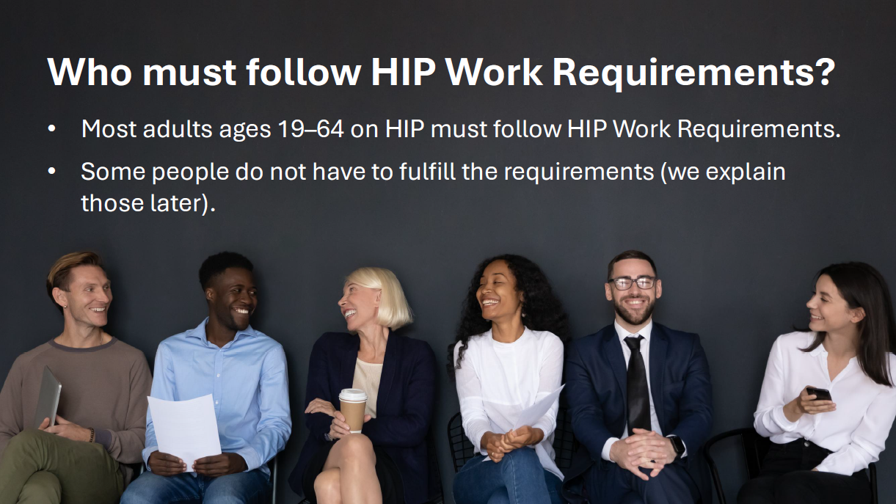

Slide 12
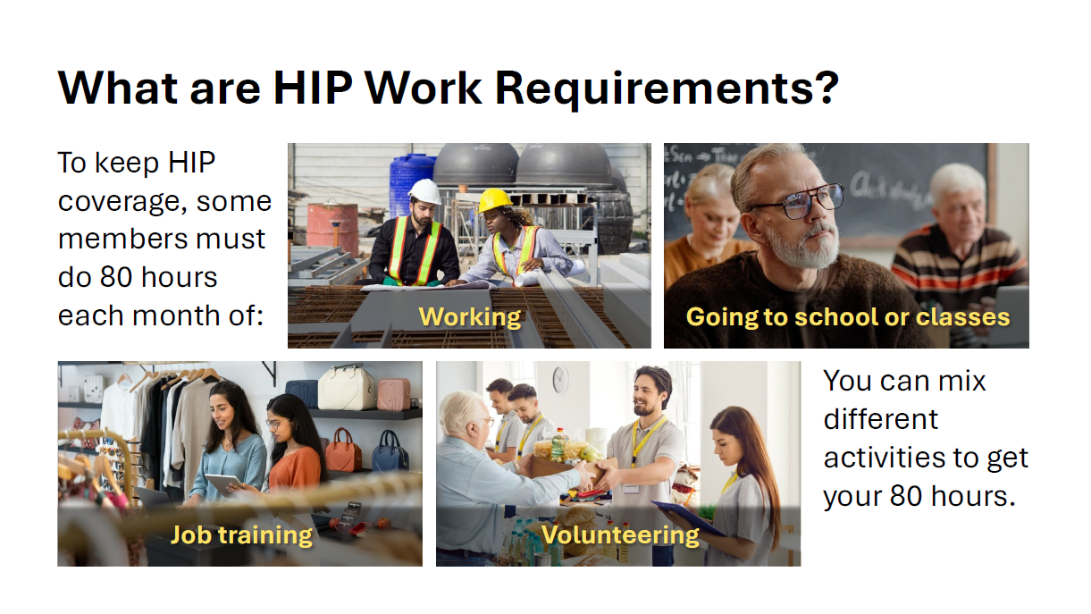

Slide 13
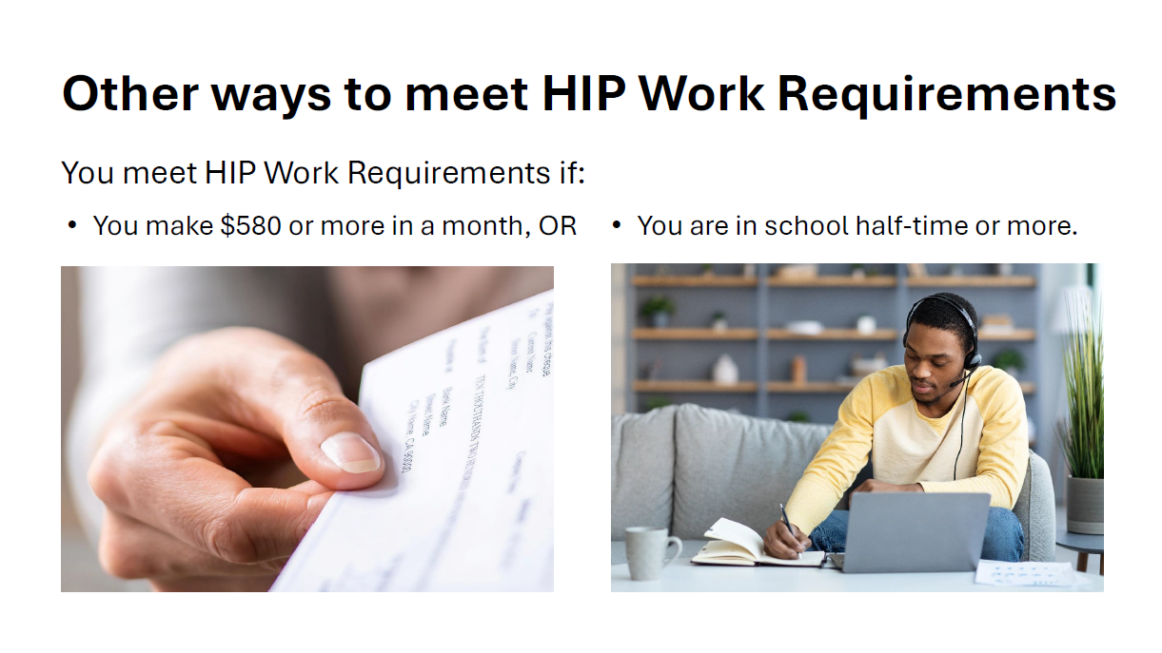

Slide 14
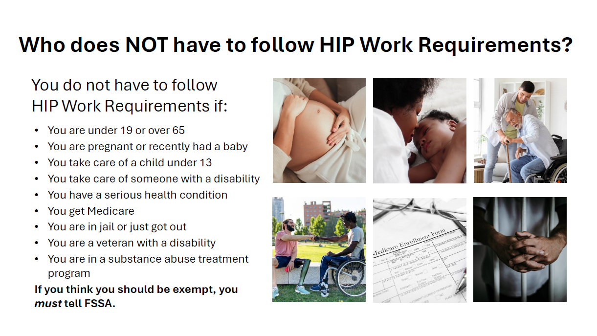
Prescreening tool for exemptions: https://hipworkscreen.in.gov/hwr

Slide 15
Medically Frail Exemption
Medically Frail is a Federal term for someone who needs enhanced, comprehensive coverage
  Currently being determined by the MCO who inform the OMPP of the status
    Patient is notified by mail by the FSSA
    The patient is listed as “State Plan” on the Medicaid Provider Portal
  January 1st, will switch to the FSSA determining Medically Frail
  Process is not completed.
  Medical providers will complete paperwork on the patient. Providers will not have to determine the medically frail status but supply the backup in some form which is not released yet.
Conditions List: https://www.in.gov/fssa/hip/am-i-eligible/conditions-that-may-qualify-you-as-medically-frail

Slide 16
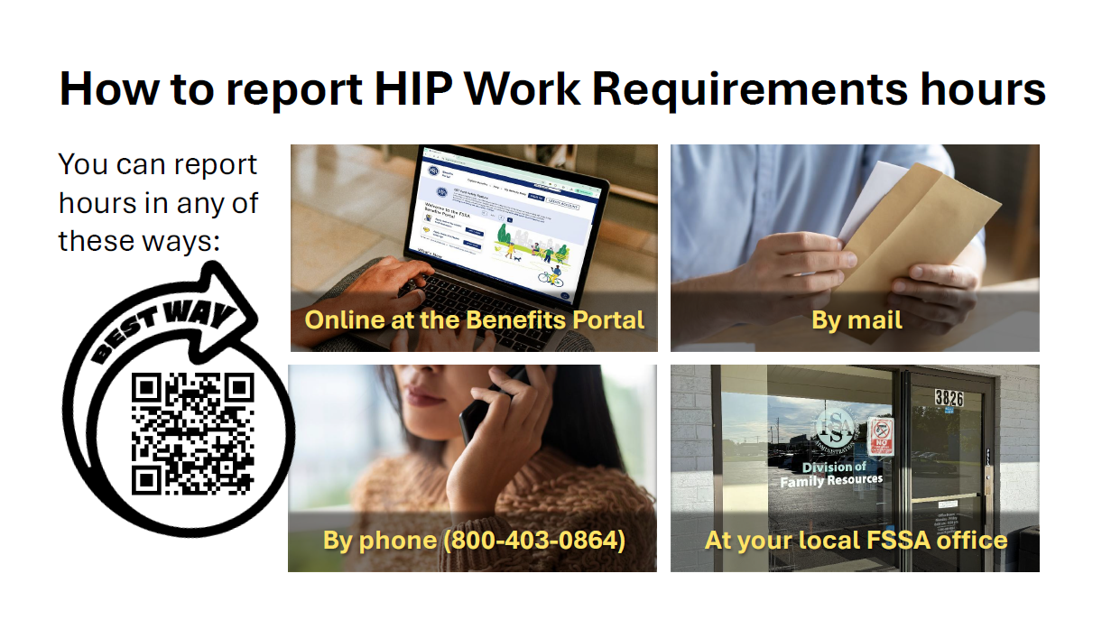
https://fssabenefits.in.gov < Benefits Portal Sign Up
To find out more about the benefits portal: https://www.in.gov/fssa/create-a-benefits-portal-account

Slide 17
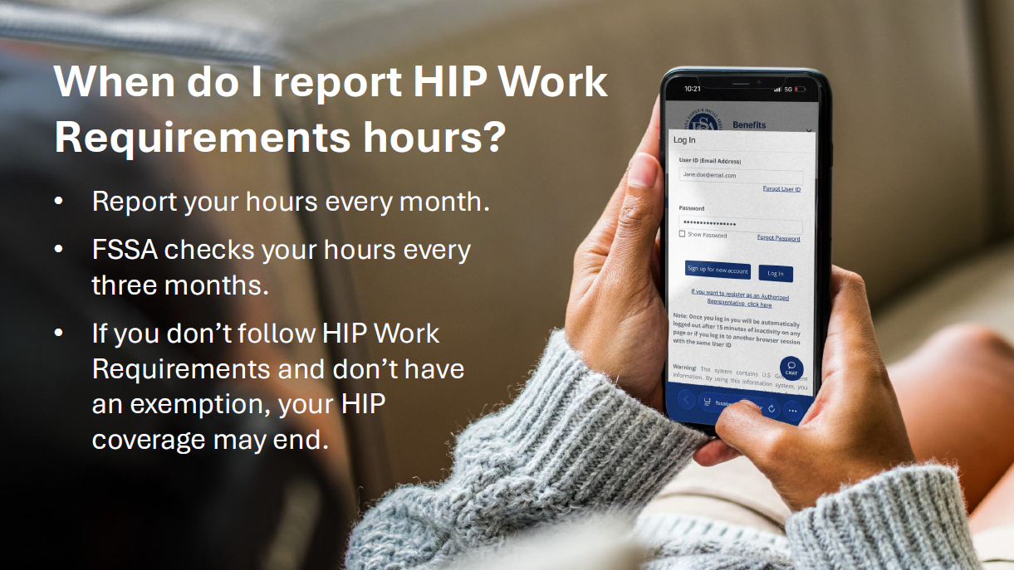

Slide 18
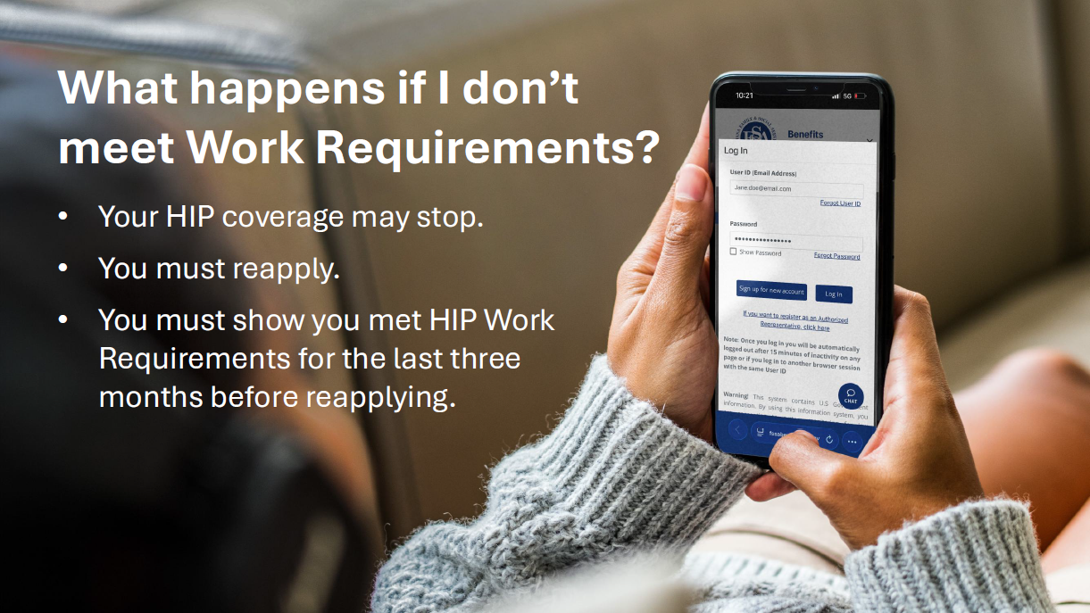

Slide 19
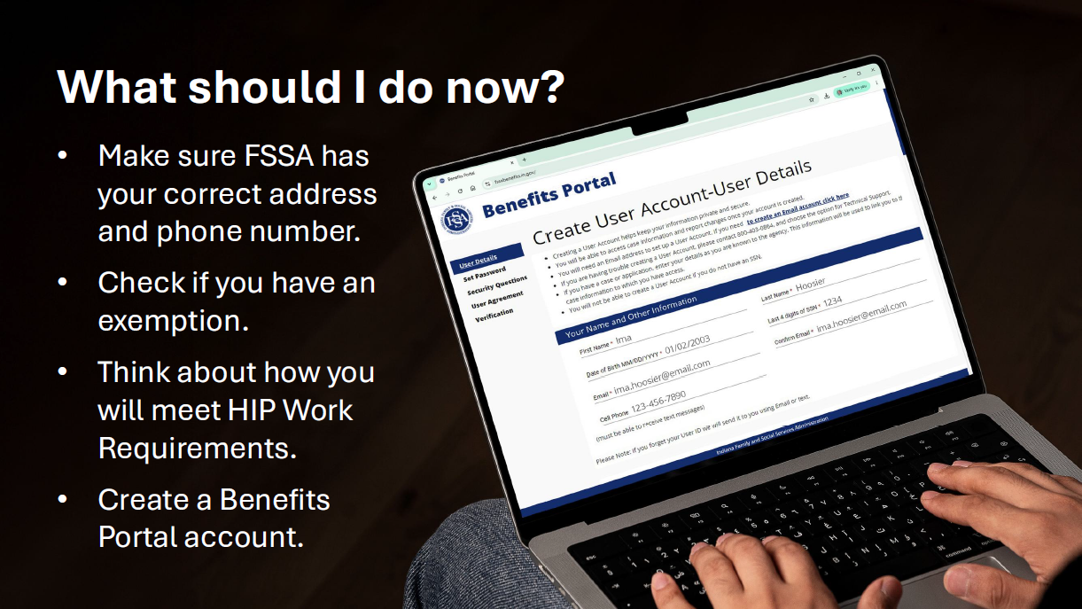
https://fssabenefits.in.gov

Slide 20
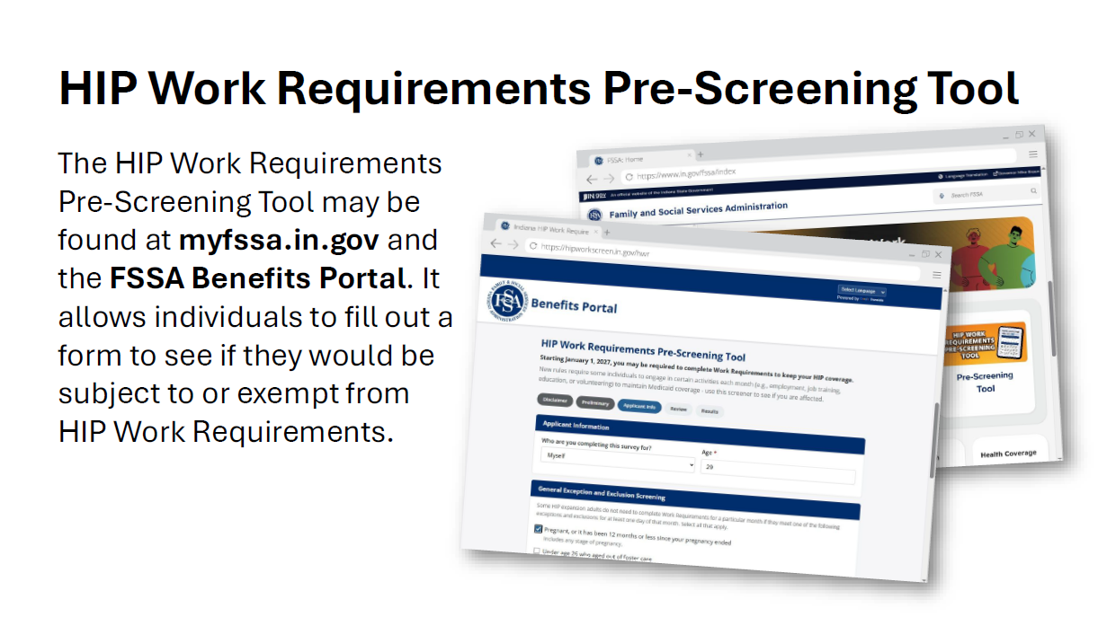
Prescreening tool direct link: https://hipworkscreen.in.gov/hwr

Slide 21

Direct Link: https://www.in.gov/fssa/hip/hip-work-requirements/hwr-partner-toolkit
FSSA HIP YouTube Videos: https://bit.ly/4j8QSIA

Slide 22




Slide 23
Federal Marketplace Insurance
Health Insurance plans that are available through the Health Insurance Marketplace, found at Healthcare.gov, which was created due to the Affordable Care Act (ACA).
This option allows you to see a variety of commercial health insurance plans, compare them based on price, benefits, and other features that may best fit your budget. https://www.healthcare.gov/see-plans/#/
Eligibility
  Live in the United States - Be a U.S citizen or national (or be lawfully present)
  Not incarcerated - Not covered or eligible for any other insurance*
Open Enrollment: ONLY during November 1 through December 15 for January coverage, and December 16-January 15 for a February 1st start date.
Special Enrollment Period: This is the 60 days before or after a life changing event that occurs to your household. This could include losing insurance coverage, death, birth, move, drastic income change, incarceration release. It is 90 days if you lose your state coverage.
Premium Tax Credit: This is the monthly discount you receive off the price of your premiums based upon the income information you provide; up to 400%. It is reconciled when you file your taxes the next year, which is required.
Cost Sharing Reductions: Discounts on the applicant’s deductible, out of pocket max, co-insurance & co-pays if a Silver plan is chosen. It is based upon your income and usually between 139-250% of poverty.
*If eligible for other insurance, it can be deemed “unaffordable” if it is over a certain percentage of your income; this percentage changes annually. It is increasing to 10.77% of the household income in 2027.

Slide 24

All the programs we have discussed can be worked with a certified Indiana navigator.
United Health Services has five navigators on staff; three that speak Spanish.
Those seeking waivers should either call Real Services or the Bureau of Disability Services.
Medicare plan choices should meet with a SHIP counselor: https://www.in.gov/ship/

Slide 25
Our Other Programs & Contacts
Breast Health Programs & BCCP
  In coordination with local hospitals and healthcare providers, the Breast Health Programs facilitate community, state, and federal funds to provide free mammography and diagnostic services for medically underserved or uninsured women in the community.
Community Services with All Deaf (CSAD)
  Coordinates ASL interpreting services, as well as provide case management and advocacy for the Deaf and Hard of Hearing community in our area. CSAD also provides community sign language classes and in-service training. Serves northern Indiana and southwest Michigan.
Diabetes Resource Center
  Works one on one with those in need of help get access to healthcare especially their diabetic medication and supplies. Our goal is to take care of the immediate crisis and then assist our clients into long term, stable solutions. Formerly known as the Diabetes Association of St. Joseph County and the Diabetes Education Center.
Suicide Prevention Center
  Provides programs to prevent suicide through education, trainings, and community-wide awareness. This program also offers compassionate grief support and resources to those who have lost a loved one to suicide. Its mission is to reduce the stigma associated with suicide and to achieve zero suicides in Indiana.
    - Yellow Ribbon Suicide Prevention for Youth, QPR Training, Applied Suicide Intervention Skills Training(ASIST)
BCCP North & Central
Regional Coordinator: Lauren D. Gorski
Ldietz@uhs-in.org
Direct Line/English: 574-314-5422 Spanish:574-314-5432, Kgarcia@uhs-in.org
CSAD
Director: Shanna Montavon- 574-514-8431
Smontavon@uhs-in.org
Assistant: Christie Maurer- 574-220-2058
Diabetes - Program Coordinator
Lauren Dietz Gorski 574-314-5422
Ldietz@uhs-in.org
Director : Kent Laudeman
574-314-5426 ext. 120
Klaudeman@uhs-in.org

Slide 26
Ed Bassler
Executive Director
O: 574-314-5423 / C: 716-868-7070
ebassler@uhs-in.org
https://uhs-in.org

